Slide 1

BIA 712
An analysis of stroke prediction using various parameters

Slide 2
The Impact of Hypertension, Heart Disease, and Lifestyle Factors on Stroke Risk: A Comprehensive Analysis of Demographic and Health Data
Objectives:
To investigate the relationship between hypertension, heart disease, and the risk of stroke.
To explore the role of BMI and glucose levels in contributing to stroke occurrence.
To evaluate the influence of lifestyle factors, including smoking status and work type, on stroke risk.
To analyze the impact of demographic factors (age, gender, marital status, and residence type) on stroke prevalence.

Slide 3
Introduction to the dataset and the purpose of your analysis
Aim
Factors of Interest
In this study we are using medical data to discover stroke predictors. With features that record lifestyle, health, and demographic data, each row represents an individual. Identifiers like ID, personal traits like age and gender, and important health indicators are all included in the columns. Additional, lifestyle characteristics are also included. Stroke, or whether the person has had a stroke, is the target variable in this analysis.
Smoking Status
Age Distribution
BMI
Average Glucose Level
Heart Disease
Hypertension

Slide 4
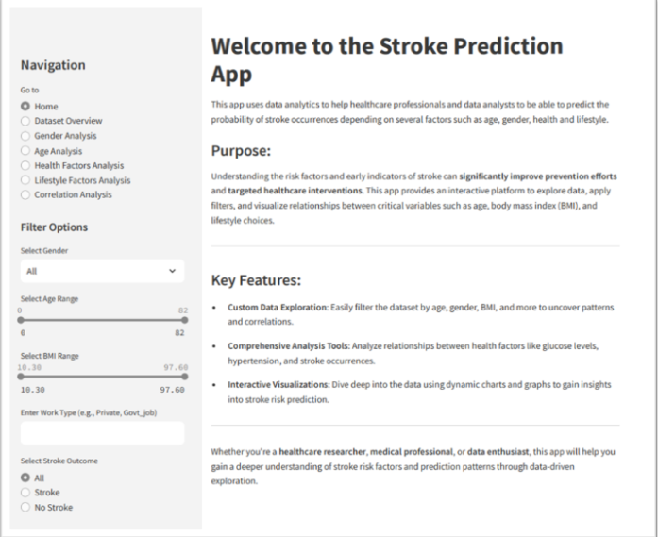
Streamlit Application – Welcome Page
App Pages navigation
The reason why the app was created
What the App consists of
Filters and sliders allow users to filter specific ranges of data while also providing the ability to apply these filters across the entire app in one step.

Slide 5
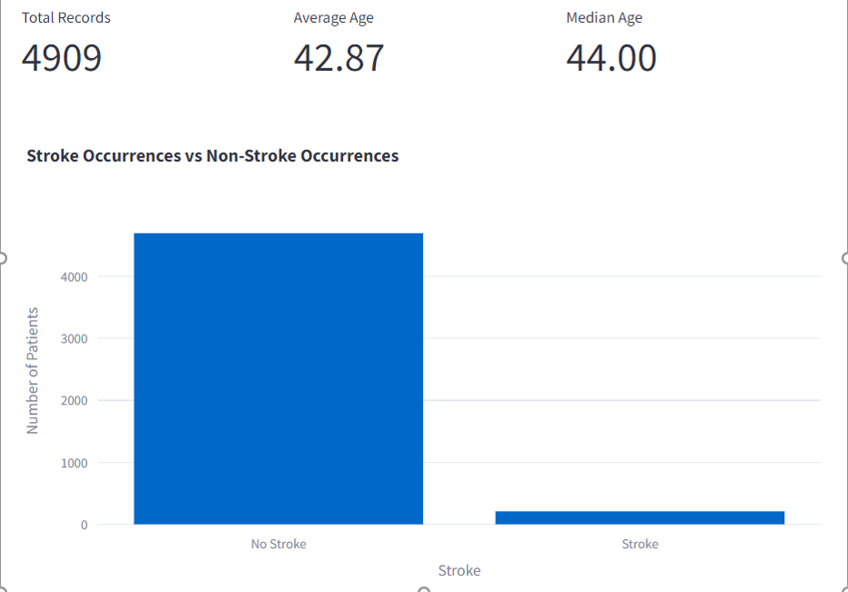
Dataset Overview

Slide 6
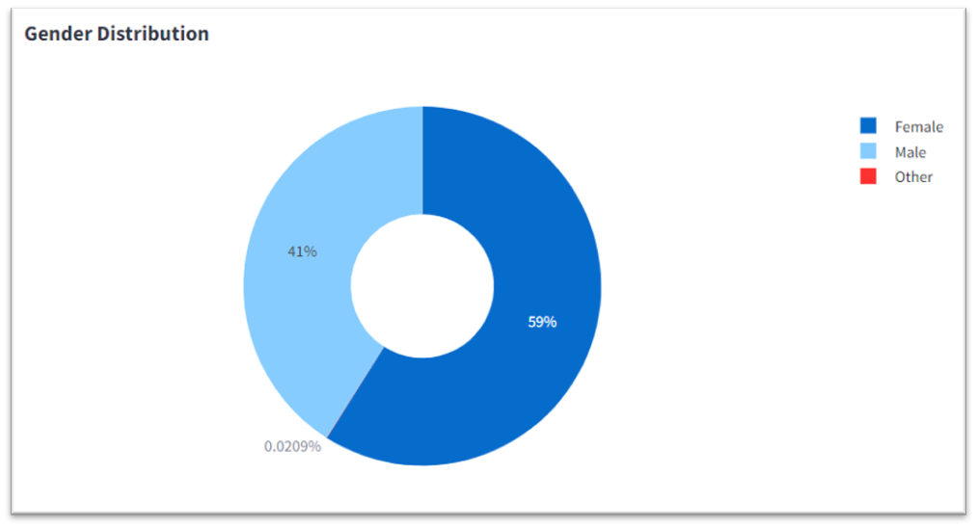
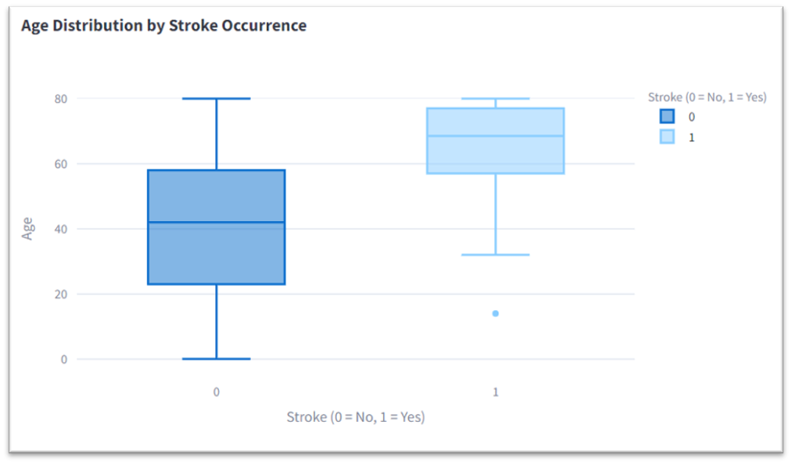
Demographic Factors
The population analysis shows that 59% are female, represented by the largest blue area, while 41% are male, depicted in a darker blue shade.
Stroke(0) : these individuals have a median age between 40 and 45, with an interquartile range (IQR) spanning from 25 to 60 years, and an age spread from about 20 to 80 years.
Stroke (1): Stroke patients have a higher median age of around 70, with an IQR from 60 to 80 years, while the age spread extends from approximately 40 to the 80s, indicating strokes are more common in older individuals but can also occur in younger people

Slide 7
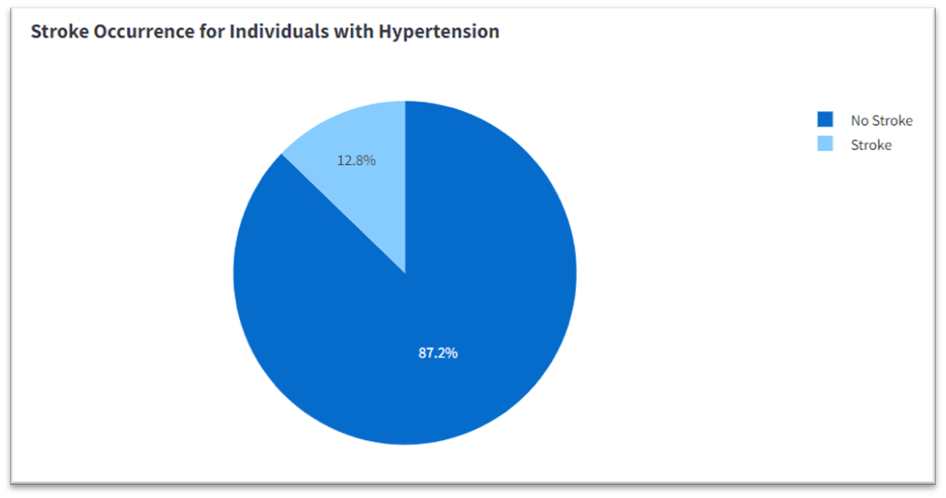
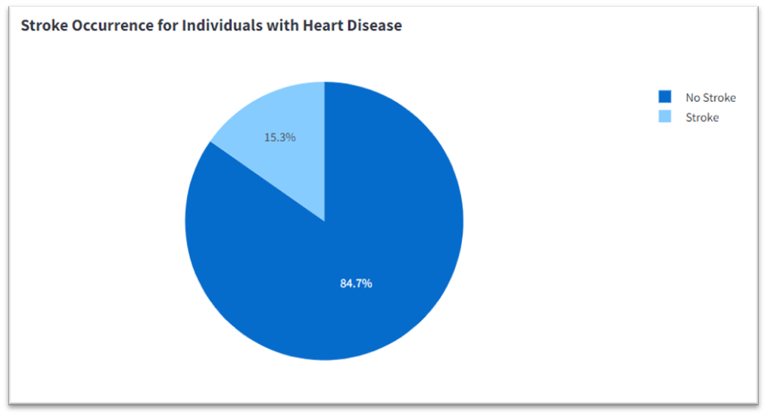
Health Factors
The chart shows that 87.2% of individuals with hypertension do not experience a stroke, while 12.8% of those with hypertension have suffered a stroke.
The chart above shows that 84.7% of individuals with heart disease have not experienced a stroke, while 15.3% have suffered a stroke.

Slide 8
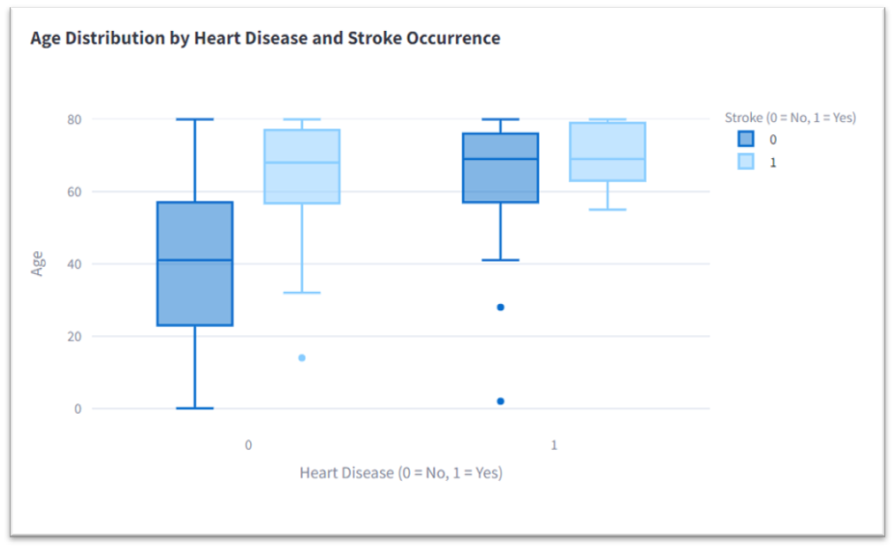
Health Factors
For individuals without heart disease, the median age is 45 for those without a stroke, ranging from 20 to 80 years, while for stroke cases, the median age increases to 70, with the middle 50% between 55 and 75 years.
Individuals with heart disease have a median age of 60 years for those without stroke, ranging from 40 to 80 years, while stroke cases show a narrower age range of 60 to 75 years, with a median of 65 to 70 years.

Slide 9
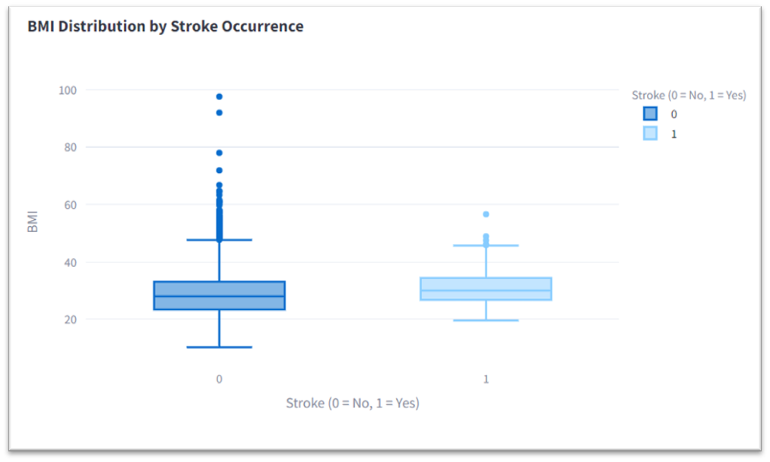
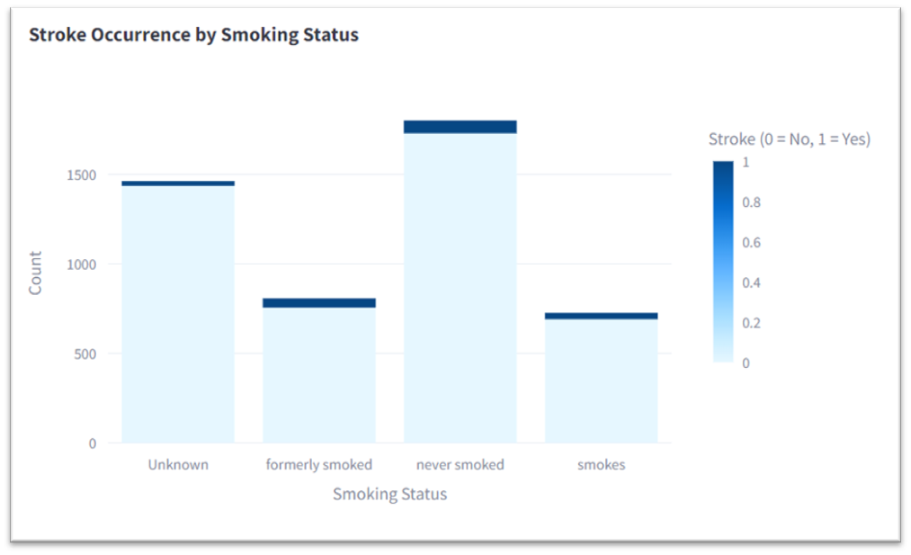
Lifestyle Factors
The boxplot shows no significant direct correlation between BMI and stroke incidence, though BMI may indirectly increase stroke risk through conditions like diabetes or hypertension. BMI values are similar between stroke and non-stroke groups, with a slightly narrower distribution among stroke patients.
The visualization shows that current and former smokers have a slightly higher stroke risk than those who never smoked, though the difference is modest and affected by the large "unknown" category. Smoking remains a stroke risk factor, especially for those with a smoking history.

Slide 10
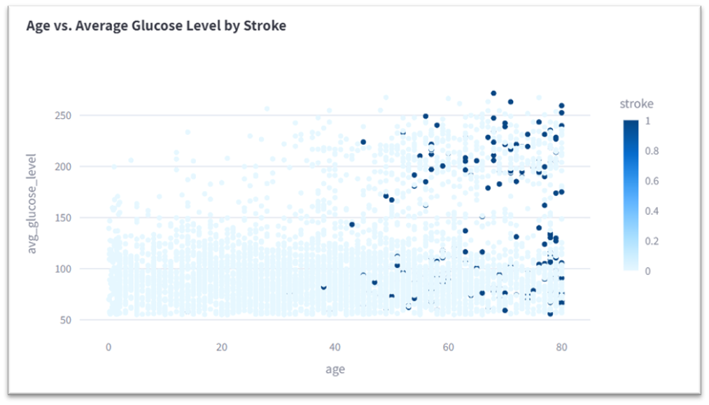
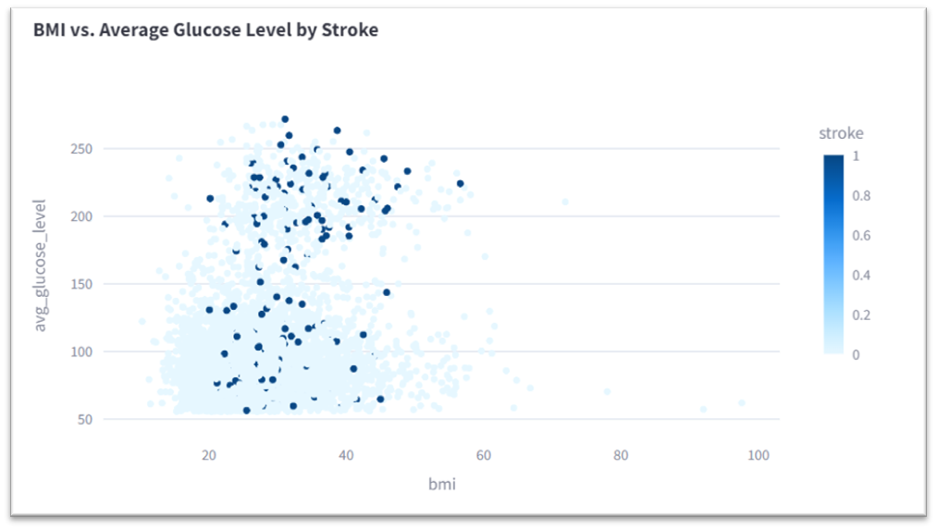
Correlation Analysis
There is a moderate positive correlation between age and glucose level (0.2333), and age is the strongest factor linked to stroke risk (0.2199). Glucose level shows a weaker but significant correlation with stroke (0.1392).
There is a weak positive correlation between BMI and glucose level (0.1171), and an even weaker correlation between BMI and stroke (0.0512), suggesting BMI is not a strong predictor of stroke.

Slide 11
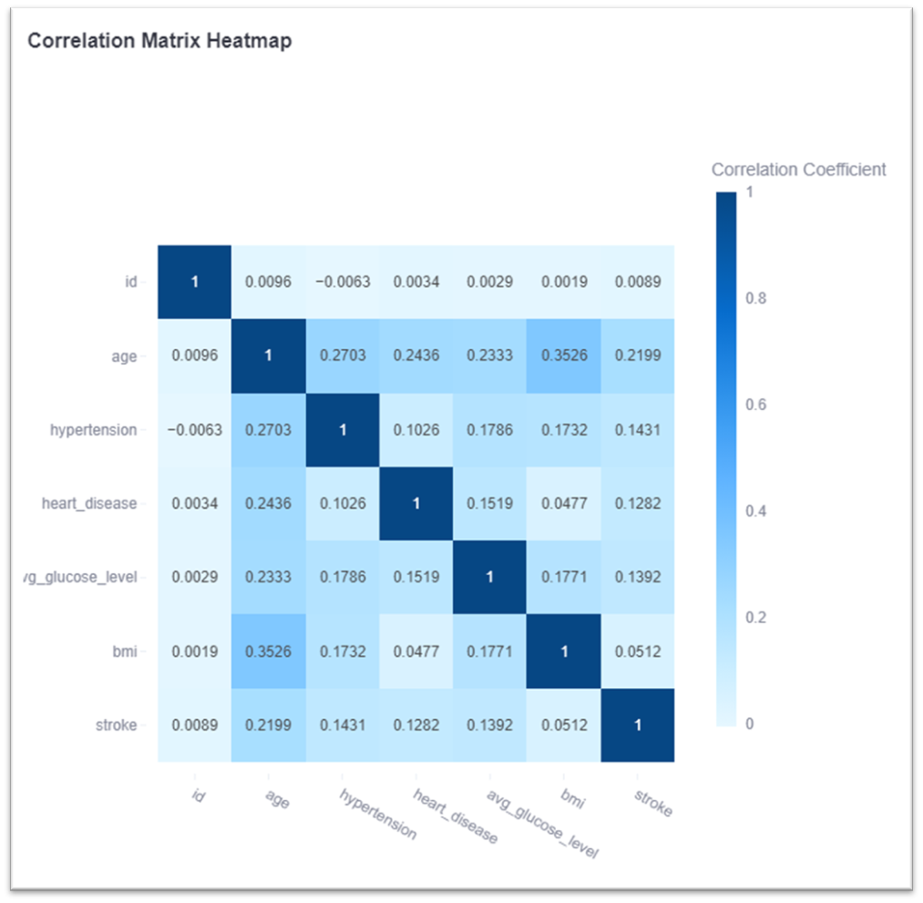
Correlation Matrix
Based on the dataset, this matrix suggests that age is the strongest predictor of stroke risk, followed by hypertension.
Average glucose level also has a weak positive correlation with stroke, but its impact is less pronounced compared to hypertension.
BMI and other health factors such as heart disease show much weaker correlations with stroke.

Slide 12
Insights
For individuals using the app to assess their stroke risk:
Age is the dominant risk factor, so older users should take immediate action to manage stroke risk factors.
Managing blood sugar levels is crucial, particularly for people with diabetes or prediabetes.
While BMI does not strongly influence stroke risk in isolation, it may still contribute to overall health complications that can raise stroke risk.
Users with hypertension or heart disease should not disregard these conditions, even though their direct correlation to stroke is weak in this dataset.
For healthcare providers or analysts using the app:
Age should be given high importance when developing predictive models for stroke risk.
A multifactorial approach is needed to assess stroke risk comprehensively, considering how different factors like age, glucose levels, and cardiovascular health interact with one another.

